Slide 1
Health Status in Tenneesee Counties in 2019
Suneethi Sivakumaran
Jan 18, 2020

Slide 2
Overview
Introduction to Dataset and Source
Questions of interest
Data Analysis
Shiny Web App
Conclusions

Slide 3
Health Status Indicators Dataset
Source : County Health Rankings & Roadmaps
A Robert Wood Johnson Foundation Program
County Health Dataset
Demographics
Mortality
Health Status
Socio-economic Factors

Slide 4
County Health Dataset
Demographics
Mortality
Health Status
Socio-economic Factors

Slide 5
Question of Interest
What are the effects of urban vs rural counties on
Health of population
Mortality
Socio-economic factors
Education
Employment

Slide 6
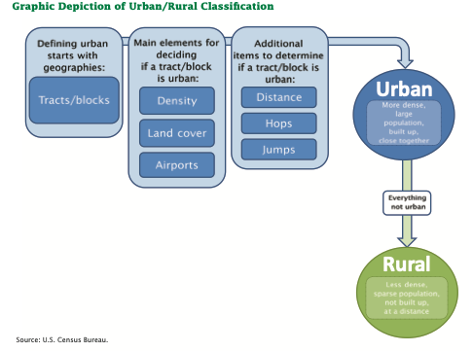
What is Rural?

Slide 7
Counties in Tennessee

Slide 8
Rural Population Percentage
Notes:
Use the new plot in R – it has the title

Slide 10
Several Counties with no Urban Population

Slide 11
Counties that are urban

Slide 12
Rural areas have less percentage of college attendance, and primary care physicians
Negative correlation with PCP Rate
And rural regions

Slide 13
Rural and Health Status

Slide 14
No particular difference between rural and urban counties in health status –Change to boxplot
Notes:
Boxplot – side by side boxplot between rural and urban, or stacked barplot.

Slide 15
Percentage of Smokers consistent among rural counties and moderate correlation with urban vs rural counties

Slide 16
Rural and Mortality

Slide 18
Rural and socio-economic factors

Slide 19
Rural Counties have lesser college going population

Slide 20
Shiny Web App Demo

Slide 21
Conclusion

